Slide 1

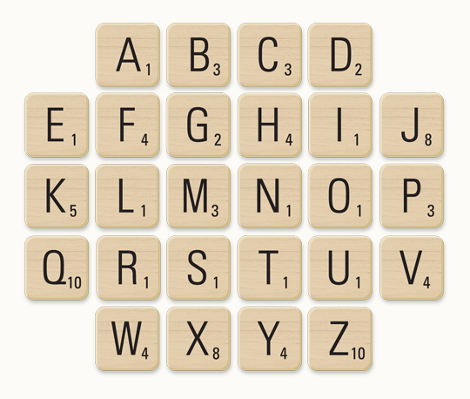
Get your word on
(4 minutes)
Think of a keyword or key term from Physics.
Spell it out using the scrabble tiles and add up your points.
House points for the best key words when:
1) You are the only one to write down and spell your word right
2) Your word scores the most points from the scrabble letters

Slide 2
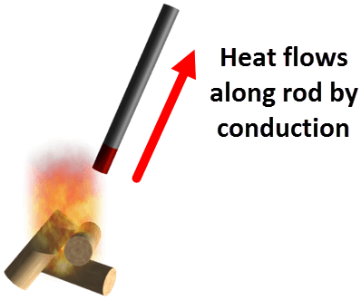
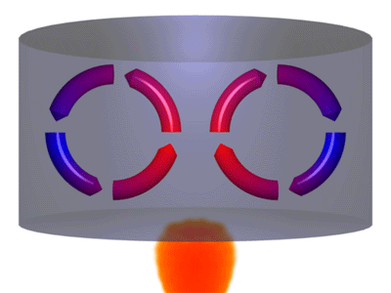
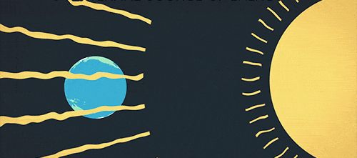
Conduction is heat transfer which occurs between objects in direct contact.
It occurs due to the movement of particles.
Convection occurs due to the movement of fluids.
This form of heat transfer occurs between objects which are not in direct contact.
Radiation is heat transfer via the emission of electromagnetic waves.
These waves do not need to travel through a medium, so they can transfer heat through the vacuum of space.

Slide 3
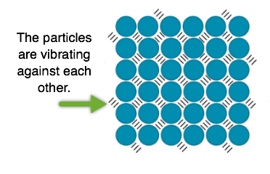
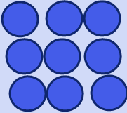
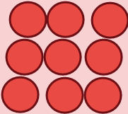
As an object gets hotter, the particles in it vibrate faster.
This means that particles in hot objects vibrate faster than particles in cold objects.
When a hot object is touching a cold object, the fast moving particles in the hot object collide with the slow moving particles in the cold object.
This causes the particles in the cold object to speed up, making the object warmer.

Slide 4
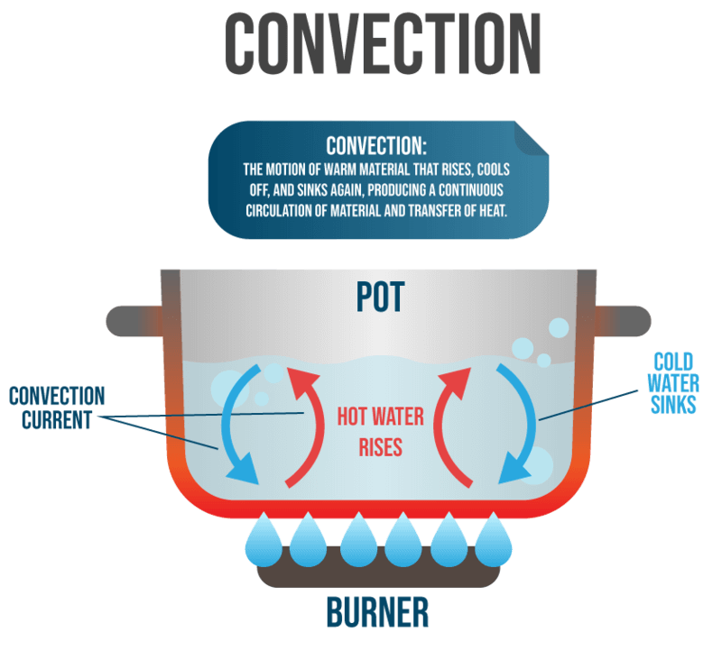

Slide 5
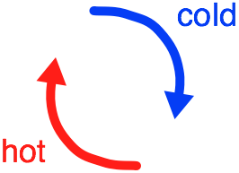
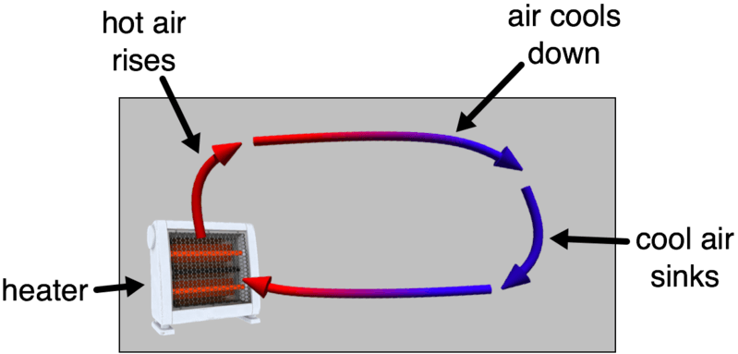
Convection is heat transfer which occurs by the movement of fluids.
When a fluid is heated, it becomes less dense and rises.
Cool fluid then moves into the space freed up by the less dense part of the fluid. This then gets heated and rises.
The heated fluid cools down as it moves away from the heat source, causing it to become more dense and sink.

Slide 6
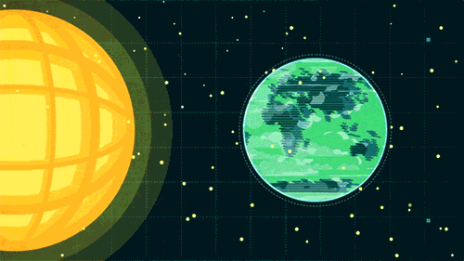
Radiation is heat transfer via electromagnetic waves.
Waves are able to travel through vacuums (like space) because they do not need particles to be transmitted. This means that radiated heat can travel through space.
A conductor is a material which transfers heat quickly.
All metals are conductors.
An insulator is a material which transfers heat slowly.
Plastic is a type of insulator. We also put insulation into our walls and roofs to keep our houses warm.

Slide 7

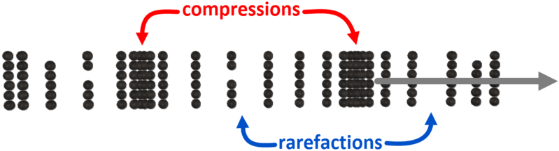
Sound waves are formed by vibrating objects. These vibrating objects push on the particles in the surrounding medium to form sound waves.
We use vocal cords to produce sound when we speak.
The particles in the medium either bunch up or spread out in response to the vibrating object.
When the particles are bunched together it is a compression.
When they are spread apart it is a rarefaction.

Slide 8


Sound waves with a high frequency have a high pitch.
Sound waves with a low frequency have a low pitch.
Loud sounds are produced by sound waves with large amplitudes.
Sound waves with small amplitudes produce quiet sounds.

Slide 9
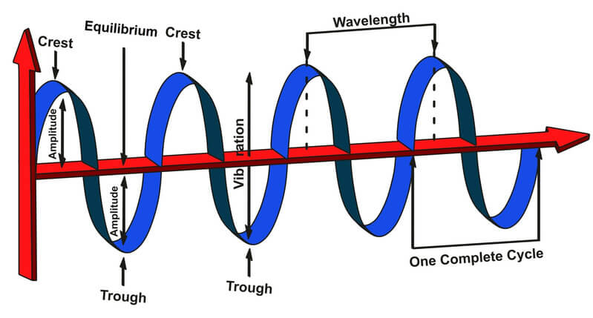
Frequency is the number of crests that pass a certain point every second.
Wavelength is the distance from one crest to another.

Slide 10
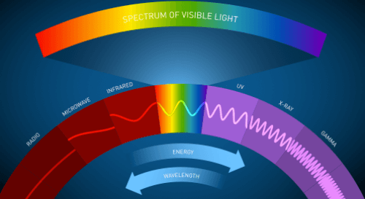
Visible light exists as part of the electromagnetic spectrum.
This is a spectrum of different types of waves. Light that we can see exists in the middle of this spectrum.
Other types of EMR include infrared, microwaves, radio waves, ultraviolet, x-rays and gamma waves.

Slide 11
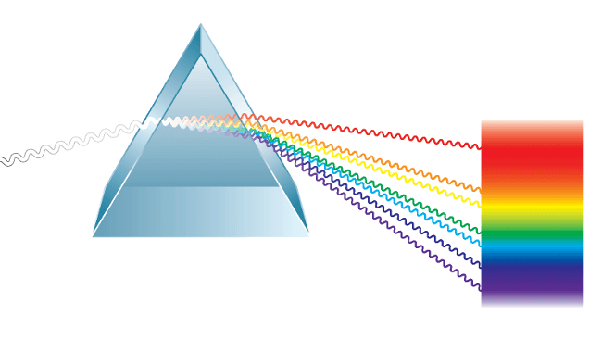
When white light passes through a prism it splits into the different colours.
This produces a colour spectrum.

Slide 12

The colour of objects is based on which colours they absorb and reflect.
For example, this blue food dye reflects blue light and absorbs all other colours.

Slide 13

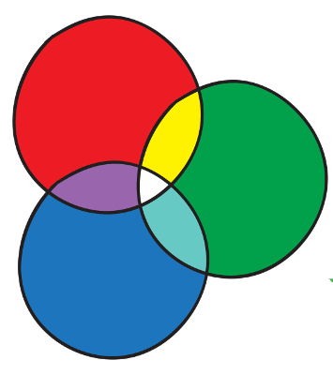
The three primary colours of light are red, blue and green.
We produce white light by shining all three primary colours together.

Slide 14
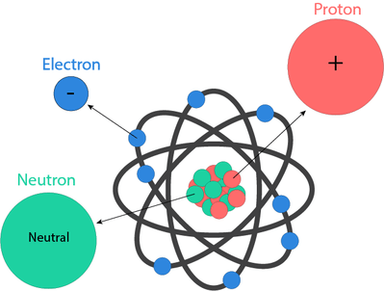
An atom is made up of subatomic particles.
These are protons, neutrons and electrons. Protons and neutrons are found in the nucleus and electrons orbit around the outside of the nucleus.

Slide 15

Subatomic particles all have a specific charge.
Protons have a positive charge, electrons have a negative charge and neutrons are neutral.
If enough electrostatic force is applied to an atom, an electron can escape from its orbit around the nucleus, taking its negative charge with it. The atom left behind then has a slightly more positive overall charge.

Slide 16
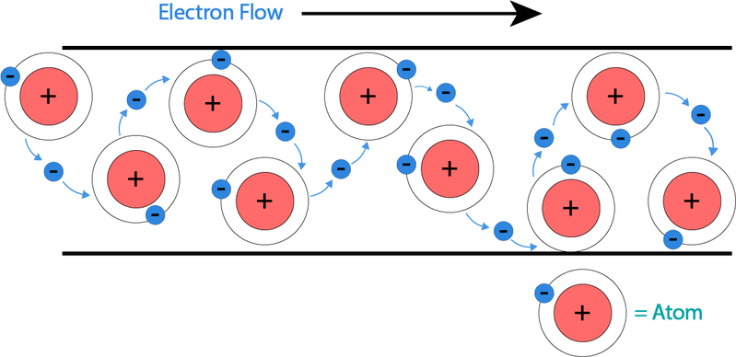
Electricity is generated by a flow of electrons.
Once an electron is freed from its atom, it looks for a nearby atom to attach itself to. The next atom then ejects an electron.
This chain of moving electrons creates a flow, which generates electricity.

Slide 17
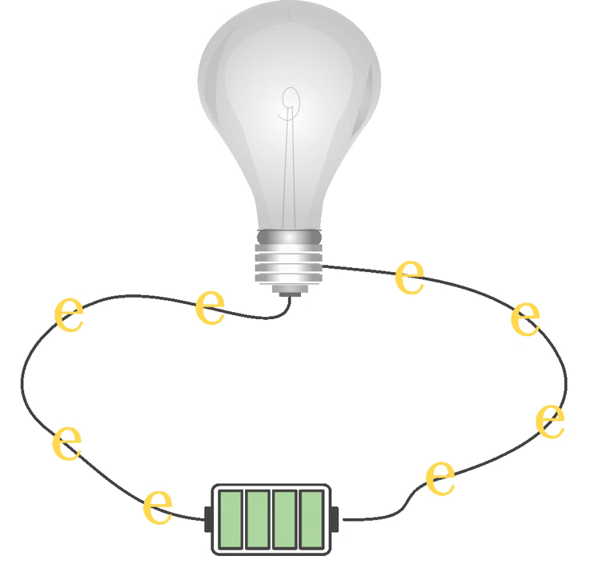
Circuits are made of multiple components.
An energy source, such as a battery or a cell, supplies energy to the circuit. This energy is used to push electrons in the wire around the circuit.
An energy user transforms electrical energy from the flowing electrons into useful energy. For example, a light bulb transforms electrical energy into light energy.

Slide 18

All the components of a circuit have to be connected.
We use wires so that electrons can flow between circuit components.
These electrons carry energy around the circuit. This means that they transfer energy from the power source to the power user.

Slide 19
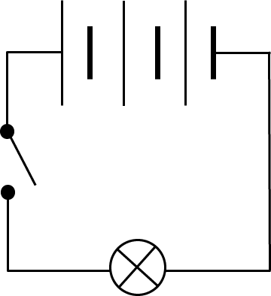
We can draw diagrams to represent electric circuits.
We use different symbols to represent different components. Everything is connected by straight lines, which represent the wires.

Slide 20
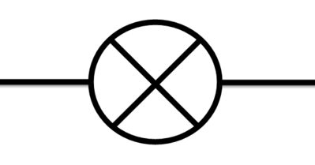
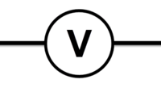
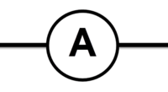
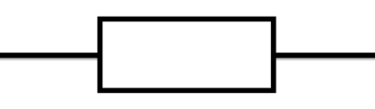
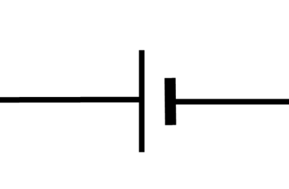
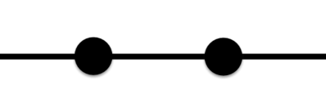
Circuit component symbols
Light bulb |  | Voltmeter
Resistor |  | Ammeter
Energy source |  | Switch

Slide 21
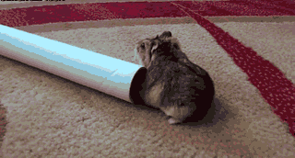
Resistance is the opposition to a current flowing through a component.
Every component in a circuit has a resistance, including the wires.

Slide 22
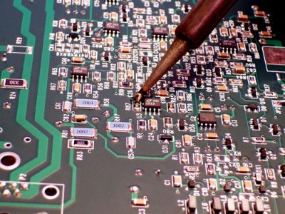
A voltage drop is a loss of energy that occurs when electrons move through a component.
As electrons travel through a component with a high resistance, they lose more energy and there is a greater voltage drop.
When electrons flow through a component with a low resistance they lose less energy than when they flow through a component with a high resistance.

Slide 23
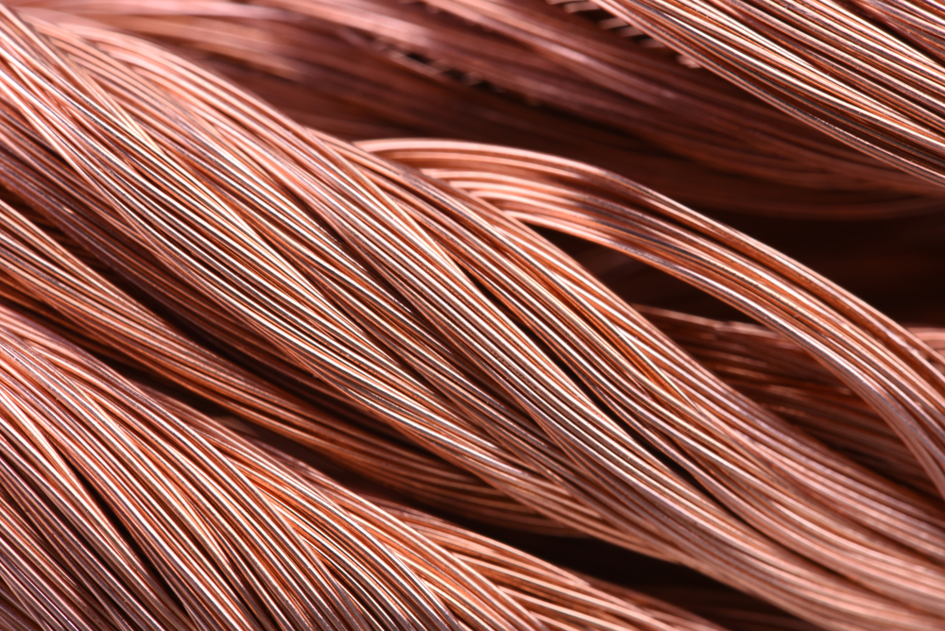
Wires also have resistance.
If a wire is longer, it has a higher resistance. This is because the electrons have to travel further, so they will lose more energy.
A wire has a lower resistance when it is wider. This is because more electrons fit into the same bit of wire and lose less energy.

Slide 24
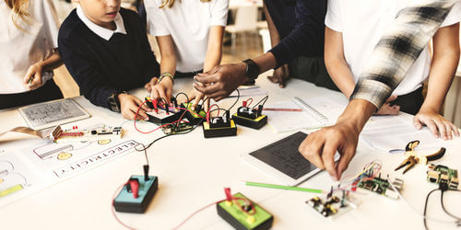
Ohm's Law applies to every circuit.
Ohm's Law links the current, voltage and resistance of a circuit together. It is represented by this equation:
V = I × R

Slide 25
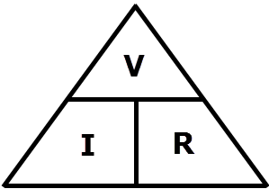
The formula can be rearranged to find different variables.
We can use this triangle as a guide to rearrange the variables. Remember, current is represented by I, voltage by V and resistance by R.

Slide 26
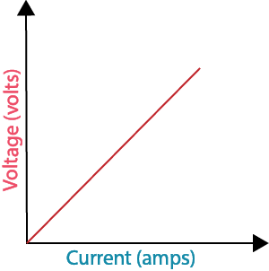
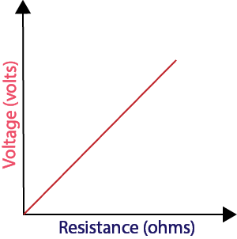
The three variables are related, so changing one will change another in a predictable way.
Voltage is directly proportional to current. By increasing the voltage, we increase the current.
If we increase the resistance, we have to increase the voltage to maintain a constant current. This means voltage is directly proportional to resistance.
.

Slide 27
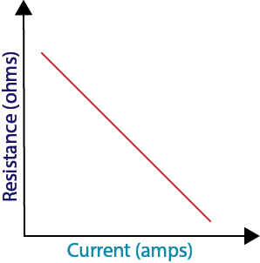
Current is inversely proportional to resistance. If the resistance is increased, the current in a circuit will decrease.

Slide 28
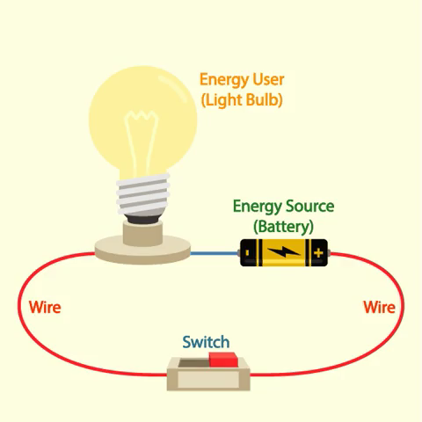
A series circuit is formed when all circuit components are on a single loop of wire.
This means that all the components are in a line.

Slide 29

Current is the same across all components in series circuits.
This is because there is only one path for the current to flow down.

Slide 30
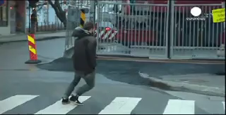
The voltage across components in series circuit depends on the resistance of the components.
If the resistance is the same, the voltage across the components will be the same.
If one component has a greater resistance than the other, that component will have a larger voltage across it.

Slide 31
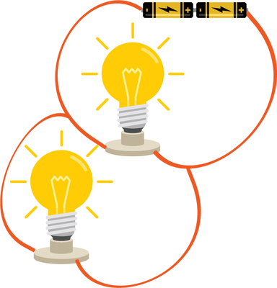
A parallel circuit is a circuit with multiple branches.
Each branch has at least one circuit component on it.

Slide 32
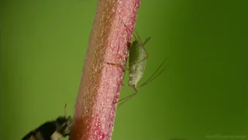
Current is split up in parallel circuits.
This is because there are multiple paths for the current to flow down, but each electron can only go down one branch at a time.

Slide 33
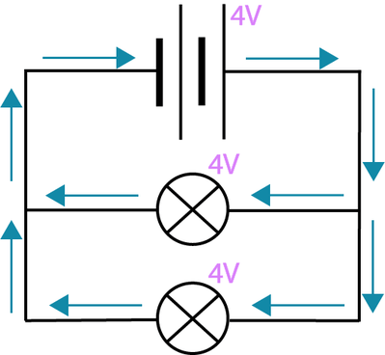
Every branch in a parallel circuit has the same voltage across them.
For example, the two light bulbs in the circuit below would have the same voltage across them.

Slide 34
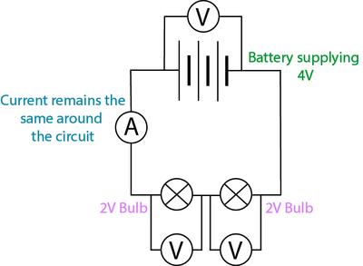
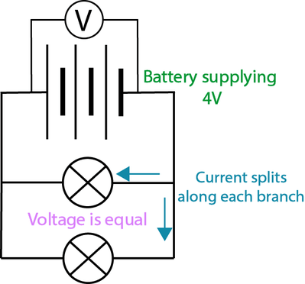
Current and voltage behave differently in series and parallel circuits.
In a series circuit, the current remains the same around the circuit, but the voltage is split between the circuit components.
In a parallel circuit, the voltage remains the same around the circuit, but the current is split between the different branches.

Slide 35
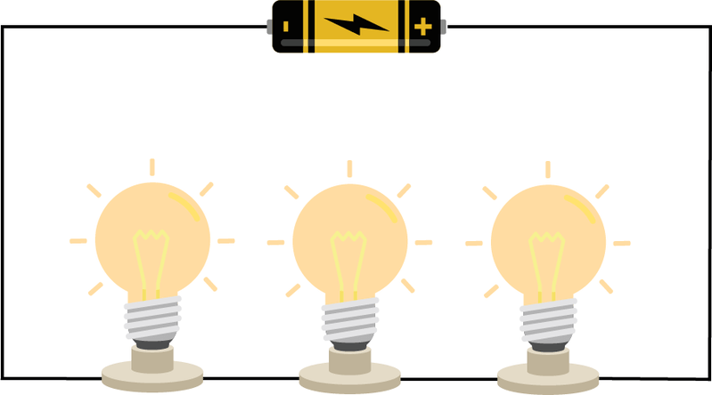
If you connect more light bulbs in a series circuit, they get dimmer.
This is because voltage is split up between components in series circuits.
This means that when more light bulbs are added, each light bulb has less voltage across them. Less voltage results in a dimmer light bulb.

Slide 36
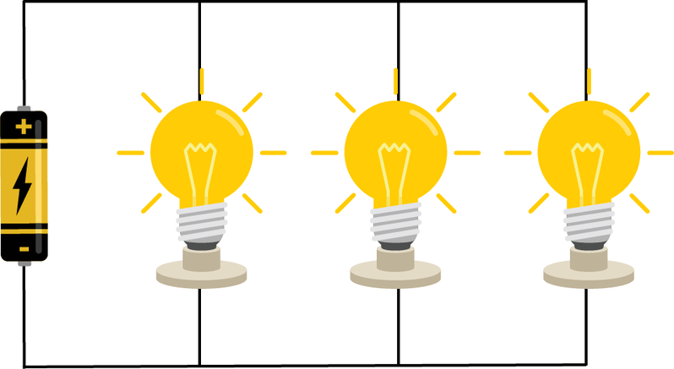
Light bulb brightness does not change in parallel circuits.
This is because voltage is divided equally in parallel circuits, so each light bulb has the same voltage across it when they are added in parallel.

Slide 37
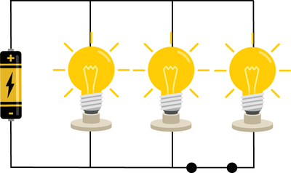
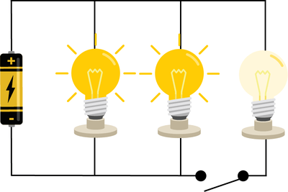
We can use switches to control individual circuit components in parallel circuits.
This is because a switch on a branch will only affect the components on that branch.

